Slide 1


Introduction to Object-Oriented Programming in Java
Classes, Objects, Encapsulation, and Basic Object-Oriented Design

Slide 2
Learning objectives
By the end of this chapter, you should be able to:
Explain the principles and advantages of object-oriented programming.
Explain the relationship between classes and objects.
Create Java classes containing attributes and methods.
Create objects and explain object state, behavior, identity, and references.
Use constructors to initialize objects.
Apply encapsulation using private fields and public methods.
Distinguish between instance and static members.
Use Java access modifiers to control visibility.
Use “this” keyword to refer to the current object.
Represent simple classes using UML diagrams.

Slide 3

Why Objects and Classes?
Opening Question

Slide 4
A Registration System Quickly Gets Complicated
Problem
String[] ids = {"S1001", "S1002"};
String[] names = {“Hawa", "Ali"};
String[] majors = {"CS", "IT"};
int[] credits = {45, 30};
The code stores two students’ information in four separate arrays. Values at the same index belong to the same student.
For example, Ali’s details are scattered across ids[1], names[1], majors[1], and credits[1].

Slide 5
A Registration System Quickly Gets Complicated
Problem
If Ali changes his major, we write:
  majors[1] = “CS";
That works, but the programmer must remember that index 1 represents Ali in every array.
Sorting students by name using java.util.Arrays.sort(names); changes the names from “Hawa, Ali” to “Ali, Hawa,” while the IDs, majors, and credits remain in their original positions.
As a result, Ali becomes incorrectly linked to Hawa’s details, and Hawa becomes linked to Ali’s. The code runs, but the student records are wrong.

Slide 6
Challenges of Using Separate Arrays
Problem
Related student data is scattered across multiple arrays.
Methods must keep matching indexes aligned.
Updates, sorting, and deletion require coordination across arrays.
As the system grows, maintaining correct relationships becomes harder and more error-prone.

Slide 7
Keeping Student Data Together with Objects
Solution
A Student class defines fields for ID, name, major, and credits.
Each object represents one student and keeps these details together.
When student objects are sorted by name, each student’s details remain associated with that student. This removes the need to keep matching indexes aligned across separate arrays.
OOP begins as a response to complexity: keep related state and behavior together.

Slide 8
Object-oriented programming (OOP)
Procedural programming is about writing procedures or methods that perform operations on the data, while object-oriented programming is about creating objects that contain both data and methods.
OOP is ideal for building scalable, reusable, and maintainable code.
Object-oriented programming has several advantages over procedural programming:
  OOP provides a clear structure for the programs
  OOP helps to keep the Java code DRY "Don't Repeat Yourself", and makes the code easier to maintain, modify and debug
  OOP makes it possible to create full reusable applications with less code and shorter development time.
Tip: The "Don't Repeat Yourself" (DRY) principle is about reducing the repetition of code. You should extract out the codes that are common for the application and place them at a single place and reuse them instead of repeating it.

Slide 9
Object-oriented programming (OOP)
In Java, the classes and objects are the basic and important features of object-oriented programming system, Java supports the following fundamental OOPs concepts :
  Classes
  Objects
  Inheritance
  Polymorphism
  Encapsulation
  Abstraction

Slide 10
Class
A class is a blueprint from which individual objects are created (or, we can say a class is a data type of an object type).
In Java, everything is related to classes and objects.
Each class has its methods and attributes that can be accessed and manipulated through the objects.
  Attributes = What an object has.
  Methods = What an object can do.
For example, if you want to create a class for students. In that case, "Student" will be a class, and student records (like student1, student2, etc) will be objects.
We can also consider that class is a factory (user-defined blueprint) to produce objects.

Slide 11
Creating (Declaring) a Java Class
To create (declare) a class, you need to use access modifiers followed by class keyword and ClassName.
Syntax to create a Java class:
  accessModifier class ClassName {
  //data members; (attributes)
  //constructors;
  //methods; (behaviours)
  ...;
  }
Java Class Naming Rules:
Start with a Capital Letter.
Use Meaningful Names.
Use PascalCase Style.

Slide 12
Example
public class Student {
String name;
int id;
double gpa;
}
This class only defines the structure of a student.
It does not create a student.

Slide 13

Real-Life Analogy
University Student Registration
Imagine the university creates a student registration template.
Template:
  Student Form
    Name:
    ID:
    Department:
    GPA:
The template describes students.
But the university needs actual students:
  Ahmed
  ID:1001
  Computer Science
  GPA:3.7
The template = Class
The actual students = Objects

Slide 14
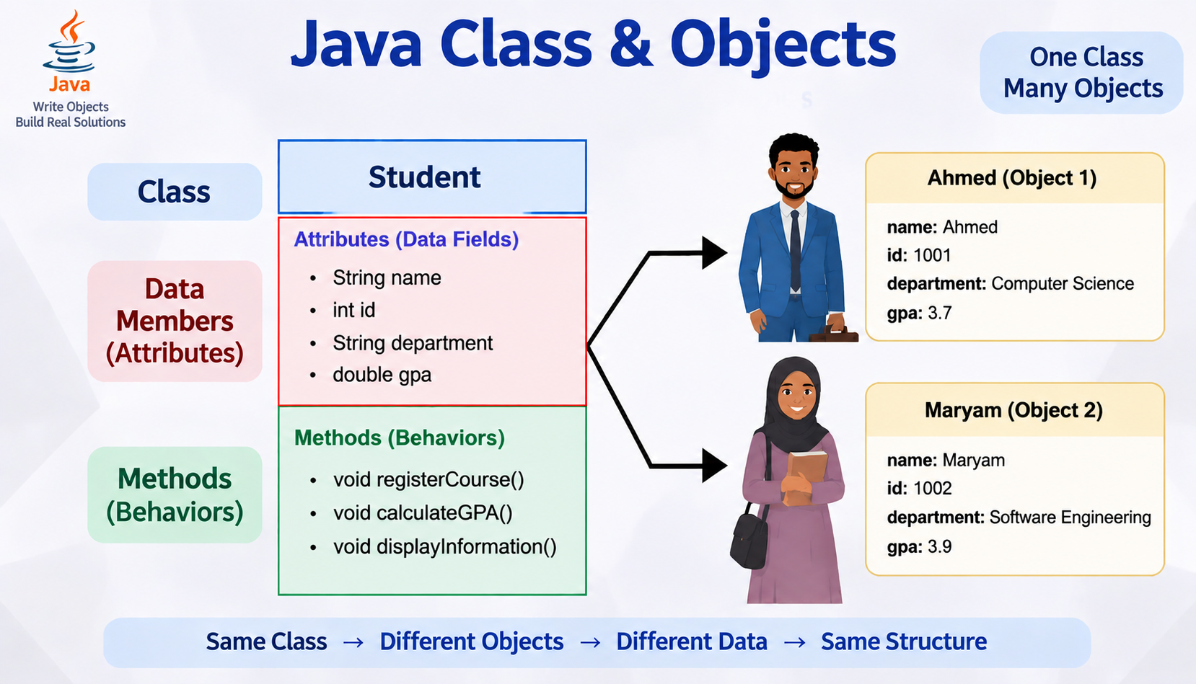

Slide 15
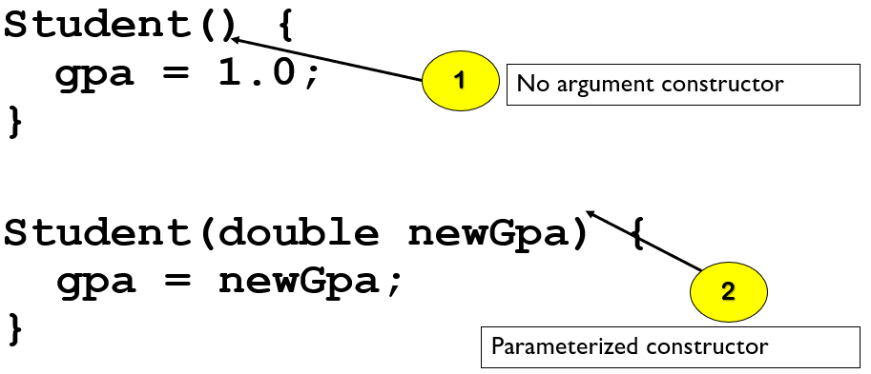
Constructors
Constructors are a special kind of methods that are invoked to construct objects.

Slide 16
Constructors, cont.
  Constructors must have the same name as the class itself.
  Constructors do not have a return type , not even void.
Constructors are invoked using the new operator when an object is created.
Constructors play the role of initializing objects.
A constructor with no parameters is referred to as a no-arg constructor.

Slide 17
Default Constructor
A class may be defined without constructors.
In this case, a no-arg constructor with an empty body is implicitly defined in the class.
This constructor, called a default constructor, is provided automatically only if no constructors are explicitly defined in the class.

Slide 18
Creating an Object in Java
An object is a real instance of a class that exists in memory.
Objects are created using the new keyword.
Syntax:
  ClassName objectName = new ClassName();
Example:
  Student ahmed = new Student();

Slide 19
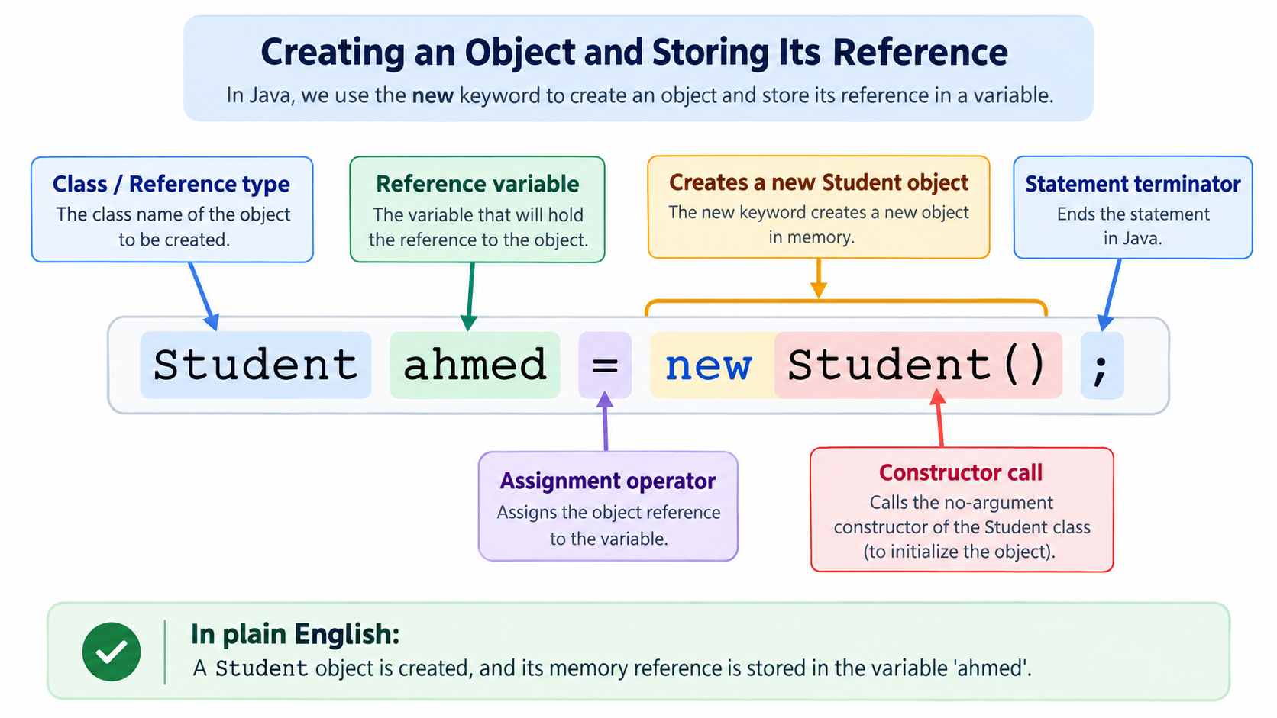

Slide 20
Accessing Object Attributes (Data Members)
To access or modify an object's data, we use the dot operator (.).
Syntax:
  objectReferenceVariable.attributeName;
Example:
  Student ahmed = new Student();
  ahmed.name = "Ahmed";
  ahmed.age = 20;

Slide 21
Invoking an Object’s Methods (Behaviors)
Objects do not only store data; they also perform actions through methods.
To execute an object's method, we use the dot operator followed by the method name.
Syntax:
  objectReferenceVariable.methodName(arguments);
Example:
  ahmed.changeMajor(“CS”);

Slide 22
Encapsulation: Hiding Data Inside Objects
Encapsulation is the OOP principle of:
  Combining data (attributes) and methods (behaviors) into one unit (class).
  Restricting direct access to an object's data.
  Providing controlled access through methods.
Encapsulation does not mean data is inaccessible. It means data is controlled.

Slide 23
Without Encapsulation (Problem)
  class Student {
  String name;
  int age;
  }
Creating an object:
  Student ahmed = new Student();
  ahmed.age = -5;
Problem:
  Anyone can directly modify the data.
Student Object :
  name = Ahmed
  age = -5
An age of -5 is not valid, but Java allows it.

Slide 24
With Encapsulation
We make variables private:
  class Student {
  private String name;
  private int age;
  }
Meaning:
  private : Data cannot be accessed directly from outside the class
Now:
  ahmed.age = -5; // is Not allowed
The object's data is protected.

Slide 25
Controlled Access Using Getters and Setters
Although data is hidden, we still need a way to read or modify it.
Java uses:
1. Getter Method
Used to retrieve data
Syntax:
public dataType getVariableName()
{
return variable;
}
Example:
public int getAge()
{
return age;
}
2. Setter Method
Used to update data safely
Syntax:
public void setVariableName(value)
{
variable = value;
}
Example:
public void setAge(int age)
{
if(age > 0)
{
this.age = age;
}
}

Slide 26
Default Values for Data Fields in Java
When an object is created in Java, its instance variables (data fields) are automatically assigned default values if no initial value is provided. These default values depend on the data type of the variable.
For reference types, such as String and other objects, the default value is null, which means the variable does not currently refer to any object. Numeric data types, such as int, double, and float, receive a default value of 0. Boolean variables are assigned false, while character variables (char) are assigned the empty character value \u0000.

Slide 27
Default Values for Data Fields in Java
For example, when a Student object is created:
  Student student = new Student();
Java automatically initializes the object's fields:
  name → null
  age → 0
  isScienceMajor → false
  gender → '\u0000'
This allows objects to be created safely even when their fields have not been explicitly initialized.

Slide 28
Default Values Are Not Assigned to Local Variables
Java treats local variables differently from instance variables. A local variable is a variable declared inside a method, and Java does not automatically assign it a default value.
For example:
  public static void main(String[] args) {
  int score;
  System.out.println(score);
  }
This code produces a compilation error because the variable score has been declared but has not been initialized.
The programmer must assign a value before using a local variable:
  int score = 0;
Java requires local variables to be initialized because they exist only temporarily during method execution. Automatically assigning values could lead to unintended results if a programmer accidentally uses an uninitialized variable.

Slide 29
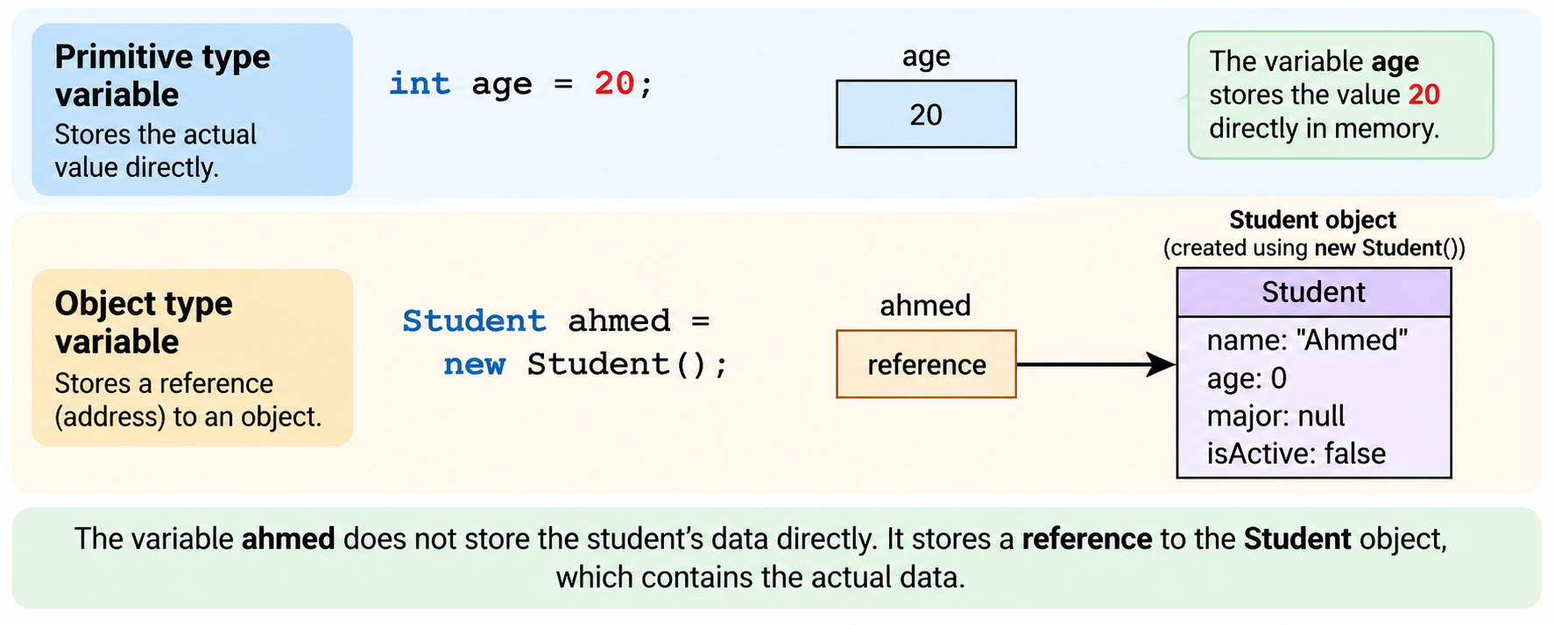
Primitive Data Types and Object Types

Slide 30
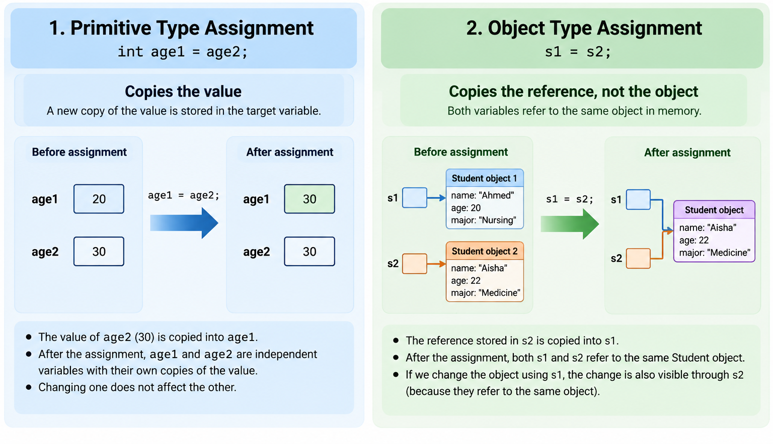

Slide 31
Instance Variables and Instance Methods
Instance variables and instance methods belong to a specific object. Every object created from a class has its own copy of instance variables and can use instance methods to operate on its own data.
Instance members are accessed using an object reference variable.
    public class Student {
    //instance variables
    String name;
    int age;
    //instance method
    public void displayInfo() {
    System.out.println(name + " " + age);
    }
    }

Slide 32
Static Variables and Static Methods
A static variable or static method belongs to the class itself, not to individual objects.
Only one copy of a static variable exists, and it is shared by all objects of that class.
Static members are declared using the keyword: static
Example: Student Class
    public class Student {
    String name; // Instance variable
    static String university = "JUST"; // Static variable
    static displayUniv(){
    System.out.println(university);
    }
    }

Slide 33
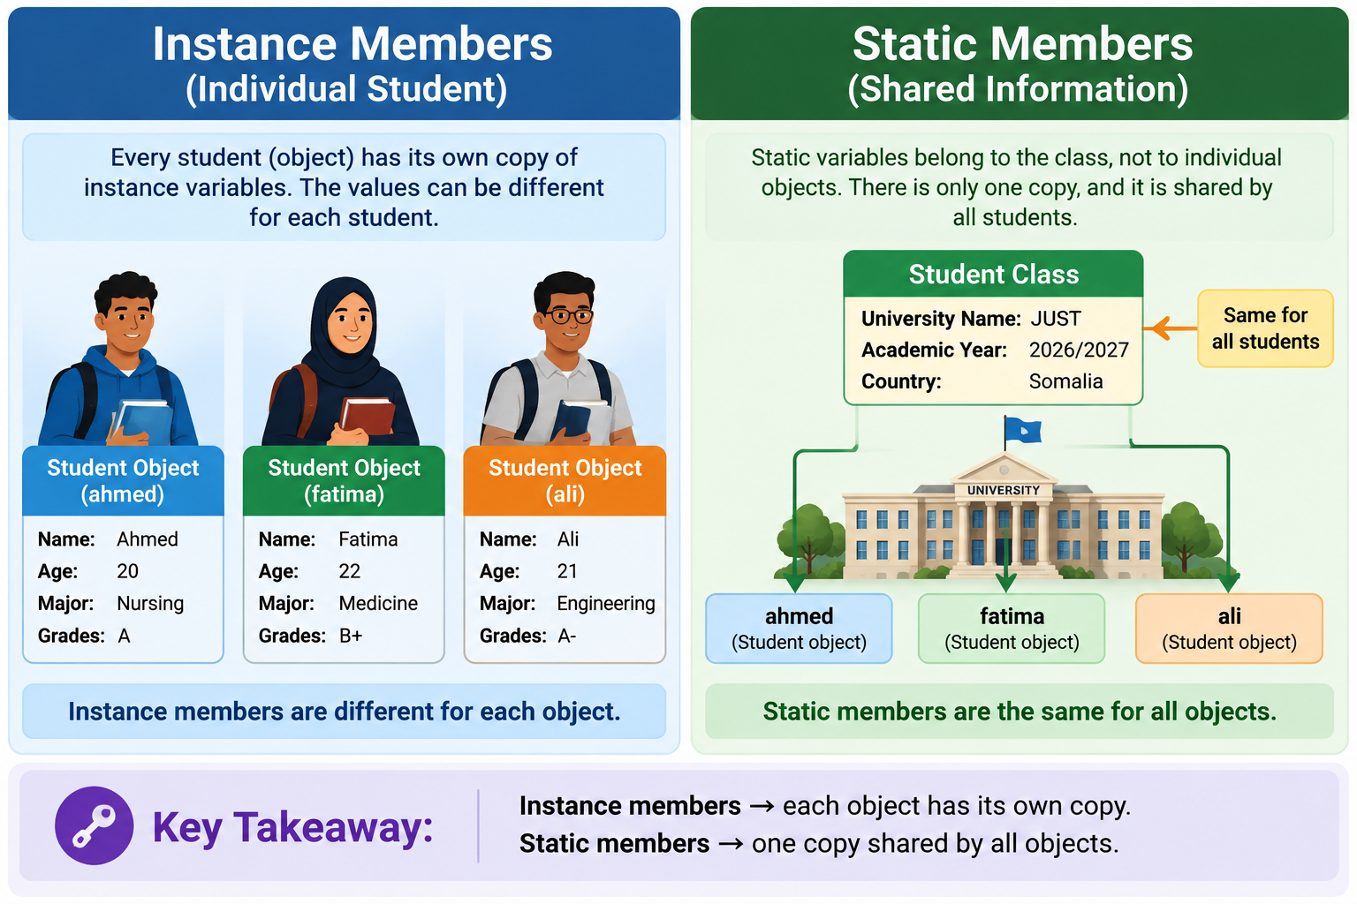
Simple Analogy : University System

Slide 34
Why Do We Use Static Members in Java?
To Store Shared Information.
To Save Memory
  Static variables reduce memory usage because the value is stored once and shared by all objects.
To Represent Class-Level Information
  Some information does not belong to one object; it belongs to the whole class.
To Create Utility Methods
  Some methods do not need object data. They perform general operations.
  Example: Math.sqrt(25);
  The method sqrt() is static because it does not depend on a specific Math object.

Slide 35
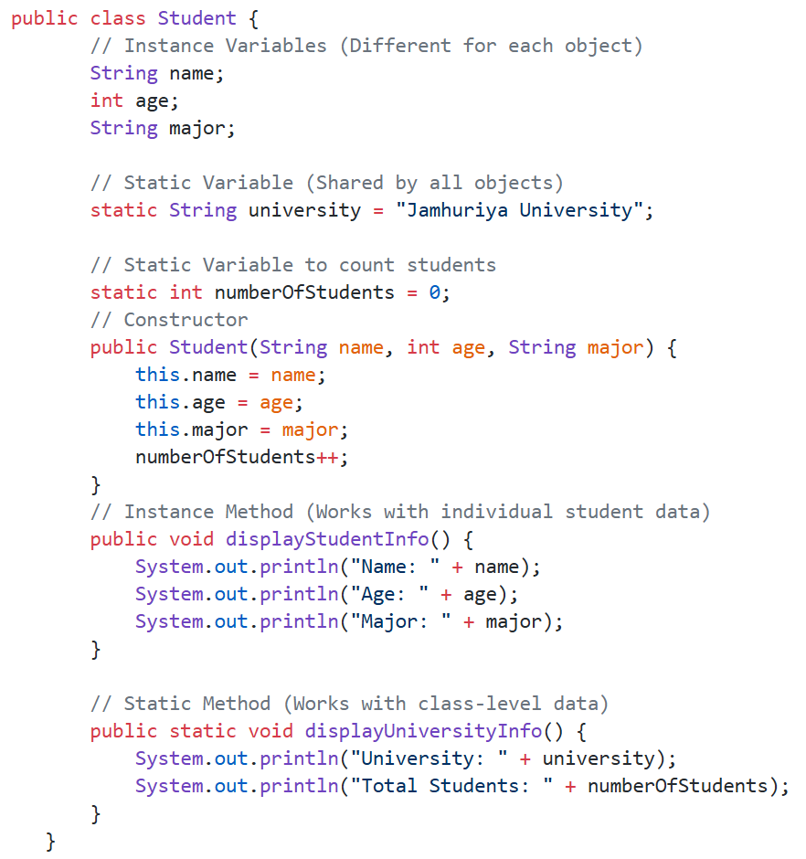
Example: Student Management System

Slide 36
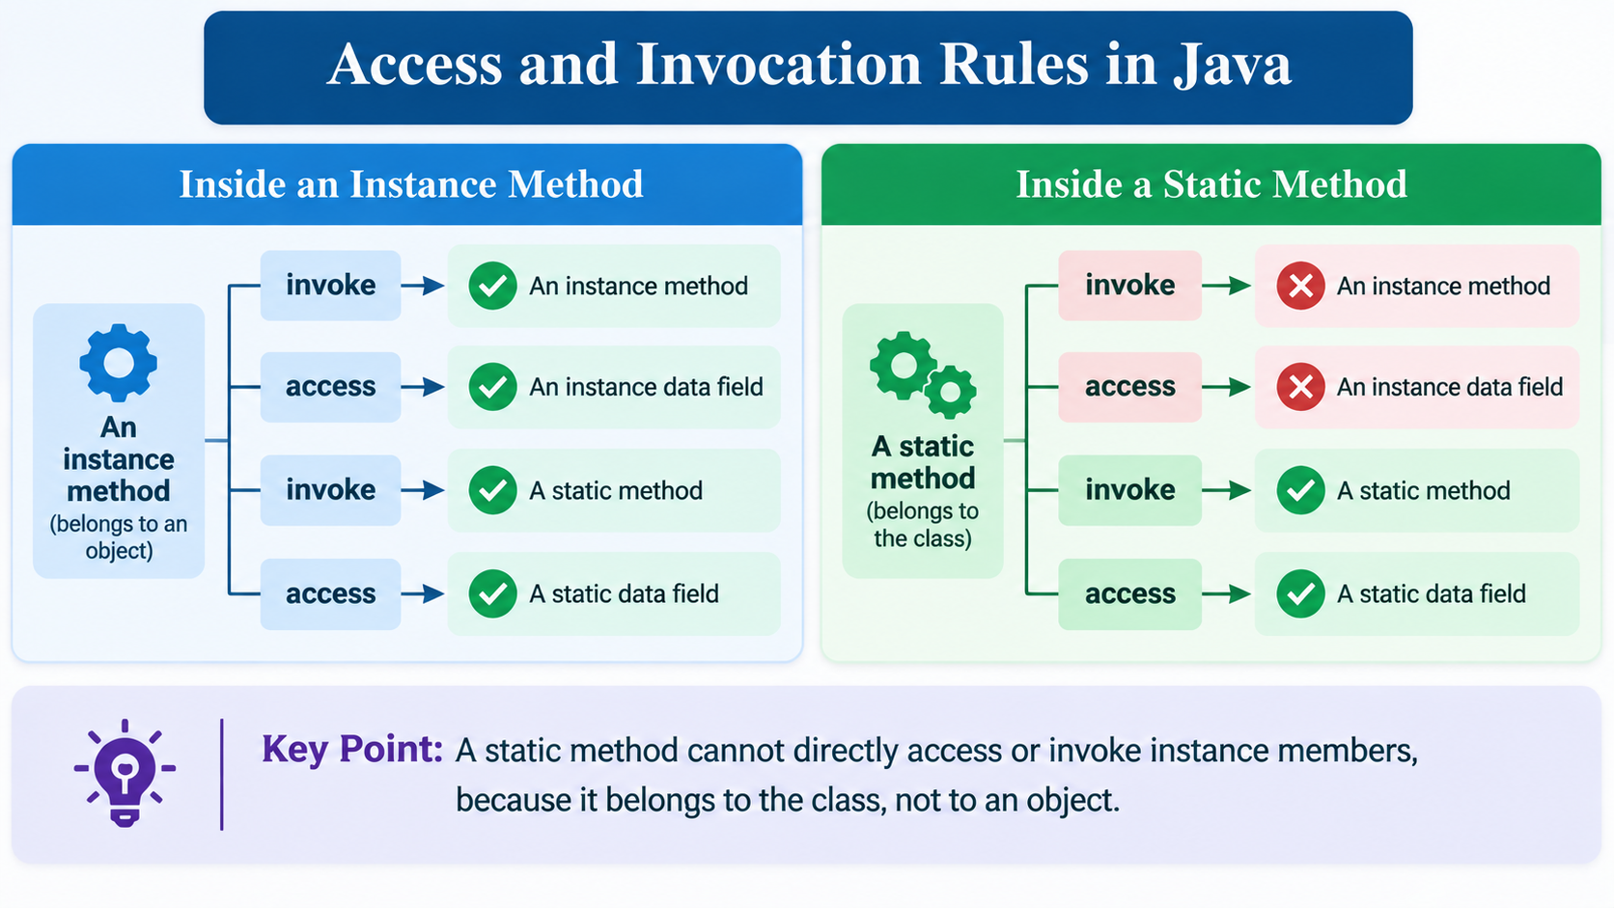

Slide 37
Visibility Modifiers in Java
Visibility modifiers (access modifiers) in Java control the access level of classes, variables, methods, and constructors.
They define who can access a member and help implement encapsulation by protecting data from unwanted access.
Java provides four visibility modifiers:
  public
  private
  protected
  default (package-private)

Slide 38
public Modifier
A public member can be accessed from anywhere in the program.
It has the highest level of accessibility.
Example:
  public class Student {
  public String name;
  public void displayInfo(){
  System.out.println(name);
  }
  }

Slide 39
private Modifier
A private member can only be accessed inside the same class.
It is mainly used for data protection and encapsulation.
Example:
  public class Student {
  private int age;
  public void setAge(int age){
  this.age = age;
  }
  public int getAge(){
  return age;
  }
  }
Why use private?
Prevent invalid data
Protect object state
Control how data is modified

Slide 40
protected Modifier
A protected member can be accessed:
  Inside the same class.
  By classes in the same package.
  By subclasses (child classes)
Example:
  class Person {
  protected String name;
  }
Child class:
  class Student extends Person {
  void display(){
  System.out.println(name);
  }
  }
The child class can access name.

Slide 41
Default Modifier (No Keyword)
When no access modifier is written, Java uses default access.
The member can only be accessed within the same package.
Example:
  class Student {
  String name;
  }
name is accessible only by classes in the same package.

Slide 42
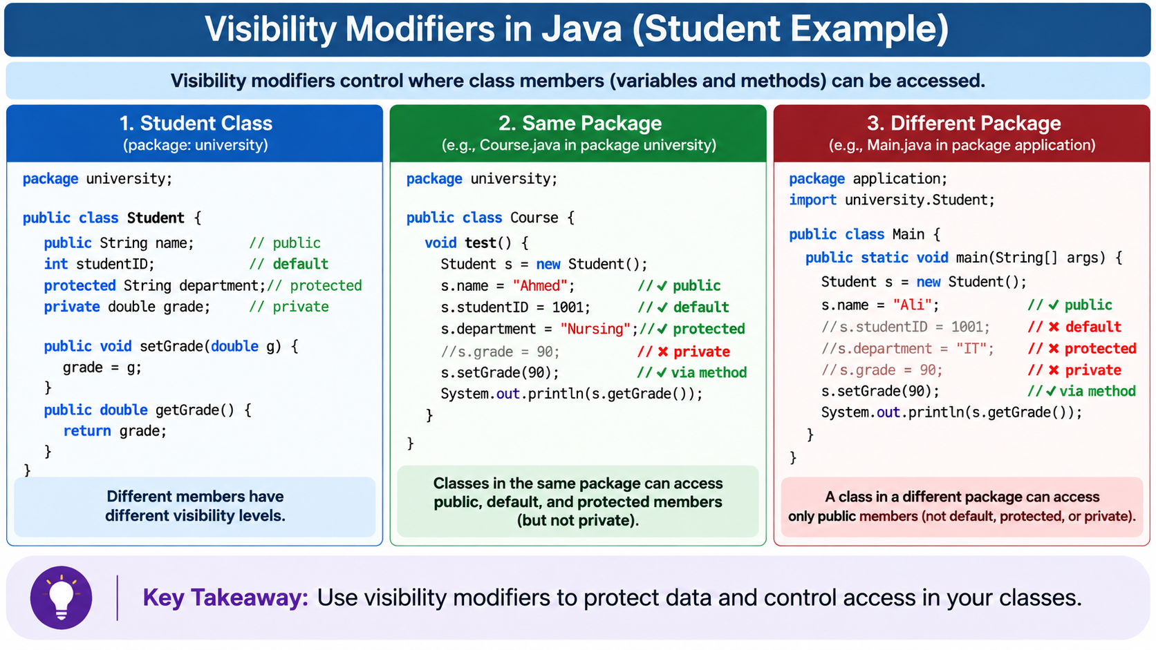

Slide 43
Visibility Comparison Table
Modifier | Same Class | Same Package | Subclass | Everywhere
private | ✅ | ❌ | ❌ | ❌
default | ✅ | ✅ | ❌ | ❌
protected | ✅ | ✅ | ✅ | ❌
public | ✅ | ✅ | ✅ | ✅

Slide 44
The “this” Keyword in Java
this is a reference that points to the current object.
It allows an object to access its own variables, methods, and constructors.
In simple words: this means 'the current object'.
Usage | Meaning | Example
this.variable | Access current object's variable | this.name
this() | Call another constructor | this("Ahmed",20)
this.method() | Call current object's method | this.display()

Slide 45
Using “this” to Access Object Variables
A common use of this is to distinguish between instance variables and local variables when they have the same name.
Example:
  public class Student {
  private String name;
  private int age;
  public Student(String name, int age) {
  this.name = name;
  this.age = age;
  }
  }
Explanation:
  this.name = name;
The first name refers to the instance variable of the object.
The second name refers to the constructor parameter.
Without this:
  name = name;
Java cannot distinguish between the two variables.

Slide 46
Using this() to Call Another Constructor
The keyword this() can be used to call another constructor in the same class.
Example:
  public class Student {
  String name;
  int age;
  public Student(){
  this(“ali", 10);
  }
  public Student(String name, int age){
  this.name = name;
  this.age = age;
  }
  }
Explanation:
this(“ali", 10);
  calls another constructor in the same class.
  It avoids repeating code.

Slide 47
Representing Classes Using UML in Java
UML (Unified Modeling Language) is a standard visual language used to design and represent classes, objects, and relationships in object-oriented programming.
Before writing Java code, programmers can use UML diagrams to plan the structure of a system.
A UML class diagram shows:
  Class name
  Attributes (variables/data fields)
  Methods (behaviors/functions)
  Visibility modifiers.
  Relationships between classes.

Slide 48
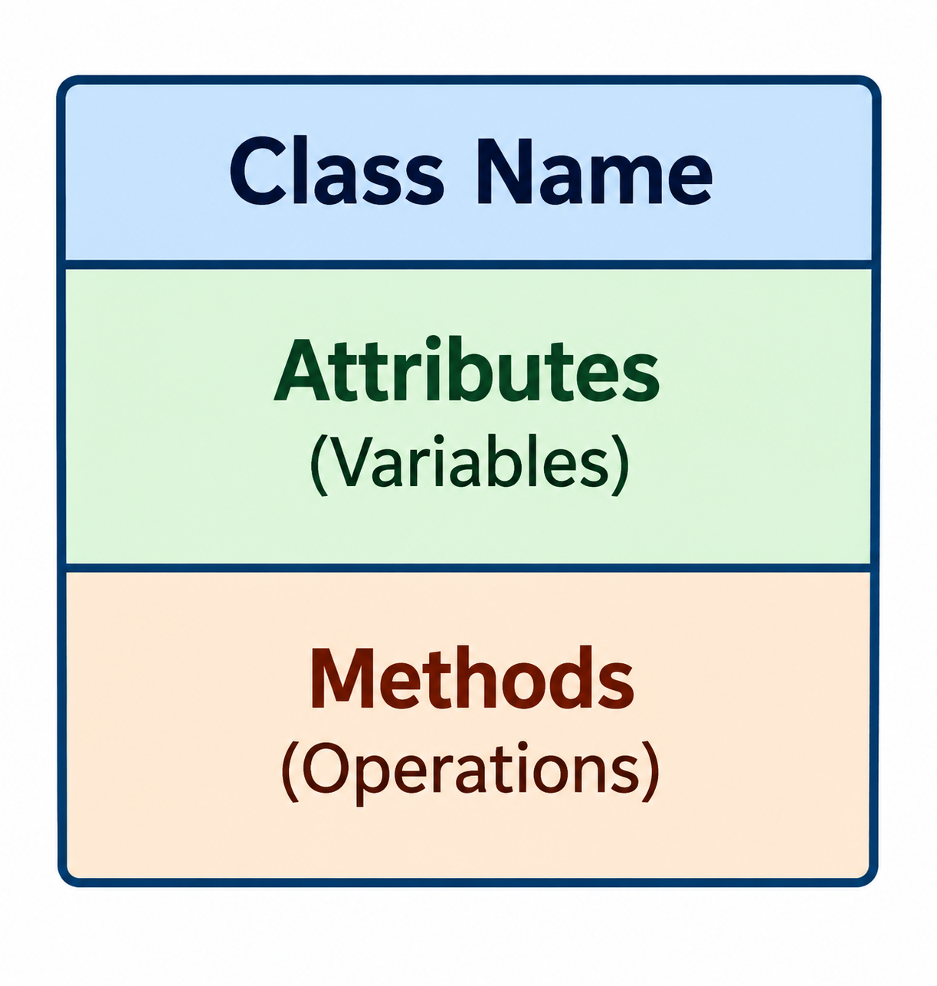
UML Class Diagram Structure
A class in UML is represented as a rectangle divided into three sections: ClassName , Attributes , and methods.
Why Use UML Before Coding?
UML helps programmers:
  Visualize class structure
  Understand relationships between objects
  Plan software design before implementation
  Communicate ideas with developers and teams
  Reduce programming errors.

Slide 49
UML Symbols for Visibility
UML uses symbols to represent Java access modifiers.
UML Symbol | Java Modifier | Meaning
+ | public | Accessible everywhere
- | private | Accessible only inside the class
# | protected | Accessible by subclasses
~ | default | Accessible within the package

Slide 50
UML Attributes (Data Fields)
UML Format:
  visibility attributeName : dataType
Example:
  - name : String //private String name;
  - age : int //private int age;
  + id : int //public int id;

Slide 51
UML Methods (Operations)
UML Format:
  visibility methodName(parameters) : returnType
Example:
  + displayInfo() : void
  + calculateGrade(score:int) : double

Slide 52
END

